Slide 1

Empirical Investigation
Occupational Employment Shares among Working-Age Adults by CZ density or MSA size

Slide 2
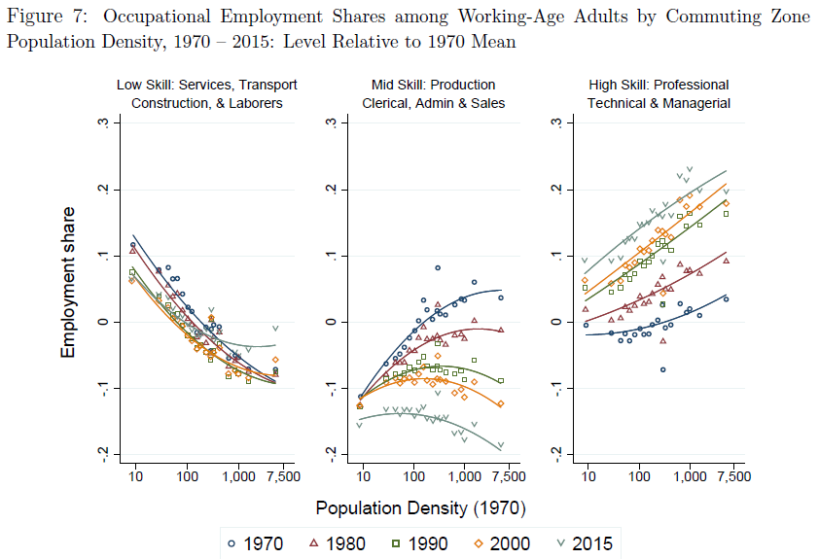
I. Previous Work: Autor (2019)
Autor, D., 2019. Work of the Past, Work of the Future. National Bureau of Economic Research.
Notes:
We are specially interested in this figure from Autor (2019), where he plotted employment share against CZ density and Each panel represents different occal category
He argue that occupational structure should vary systematically with population density.
I will talk more about the results he found in the later part

Slide 3
I. Previous Work: Autor (2019)
We are interested in the following
Occupational employment shares by MSA size (i.e. MSA population) instead of CZ density, 1980-2015.
Pin down each MSA population at 2015 for plotting, while Autor chose 1970 population density as run variable.
Follow Autor’s occupational classifications “occ1990dd” developed by Dorn (2009).
Apply alternative occupational classifications to see the difference. PCS (the French classification) and the definition used in Cerina et al. (2019).
Consider only US-born workers apart from all working-age adults

Slide 4
I. Previous Work: Autor (2019)
We are interested in the following
The difference in employment share between 1980 and 2015 & between 1990 and 2015 with all MSAs and also their groups.
Group the MSAs into 5 & 6 bins and replot the employment shares as well as the changes:
<100k, 100k-500k, 500k-1m, 1m-5m, 5m-10m, >10m. (5 bins)
200k-500k, 500k-1m, 1m-2m, 2-5m, 5m-10m, >10m. (6 bins)
Notes:
Then we have the following standards for defining the city groups based on their sizes.
And replot

Slide 5
II. Data Source
Autor (2019): Figure is constructed using U.S. Census of Population data for 1970, 1980, 1990, and 2000, and pooled American Community Survey (ACS) data for years 2014 through 2016, sourced from IPUMS Ruggles et al. (2018).
We use the same but newer version of IPUMS USA data Ruggles et al. (2020).
For MSAs definition and population data, we collect it from the website of US Census Bureau.
Notes:
So about the data source
- We follow autor’s data selection use the same but newer version of 诶噗木思 USA data

Slide 6
III. Assumptions on Treating the Data
Autor (2019): Employment share is defined as share in total work hours. Labor supply is measured as weeks worked times usual hours worked weekly.
Each panel, he subtracts off the overall mean share of employment in the relevant occupational category in 1970, so plotted points correspond to the CZ's share of employment in the occupational cluster relative to the aggregate mean share in that cluster in 1970. (We follow this treatment as well).
The replication data for Autor (2019) only includes the final panel dataset with respect to CZs, their occupational employment shares, population density, as well as do files for plotting.

Slide 7
III. Assumptions on Treating the Data
We need to impose some more assumptions on treating the micro-level census data,
We first choose 2015 MSAs definitions because it changes over time.
We use county groups to match 1980 MSAs and state & county FIPS codes to match 1990-2015 MSAs.
After imposing occupation classifications and matching workers to MSAs, employment share in each MSA is calculated by the ratio of total hours worked of certain occupation over the total hours worked among all workers.

Slide 8
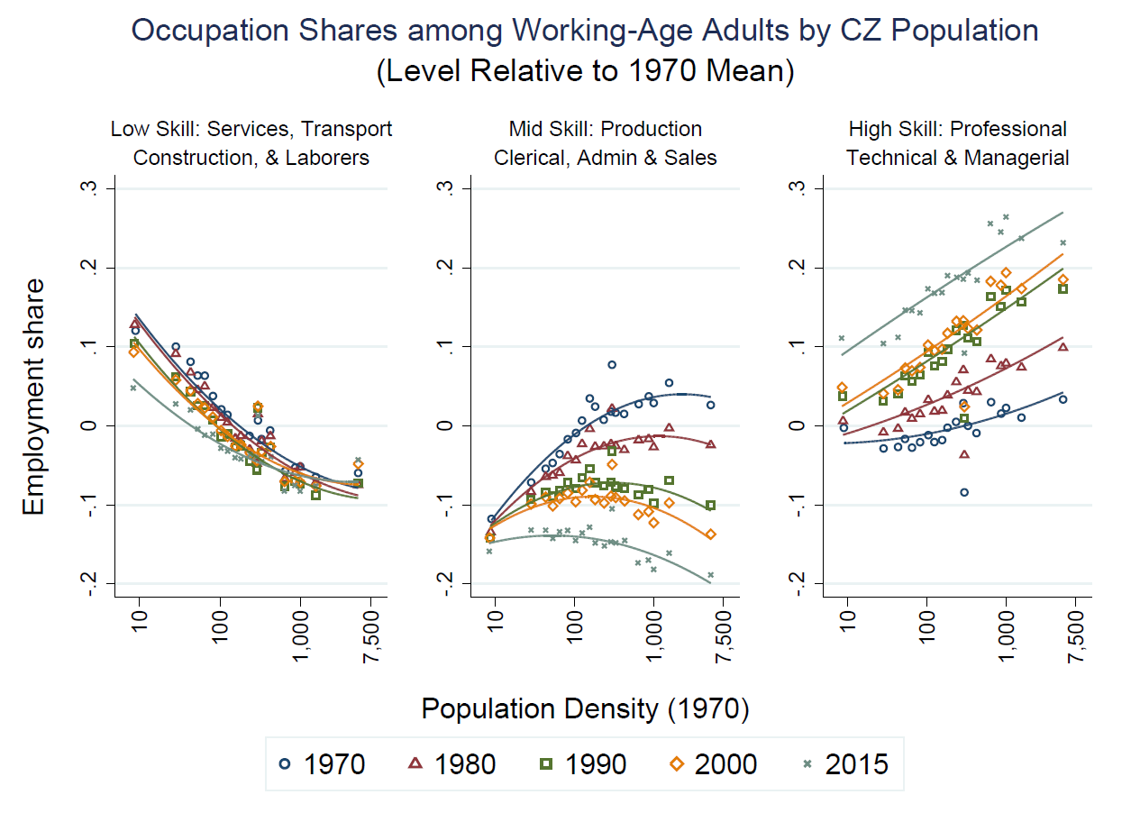
III. Assumptions: Reproduce Autor (2019) Figure 7
Notes:
We have a similar graph but with a slightly-off line for 2015
We can have a more accurate line with the right cross-walk file for 2015 occ to autor-dorn definitions
Now we can only find the crosswalk files on Prof. D Odrn’s website for 1980-2005 census data.
Here I first match occ2015 to occ2005 and then apply the latest crosswalk files

Slide 9
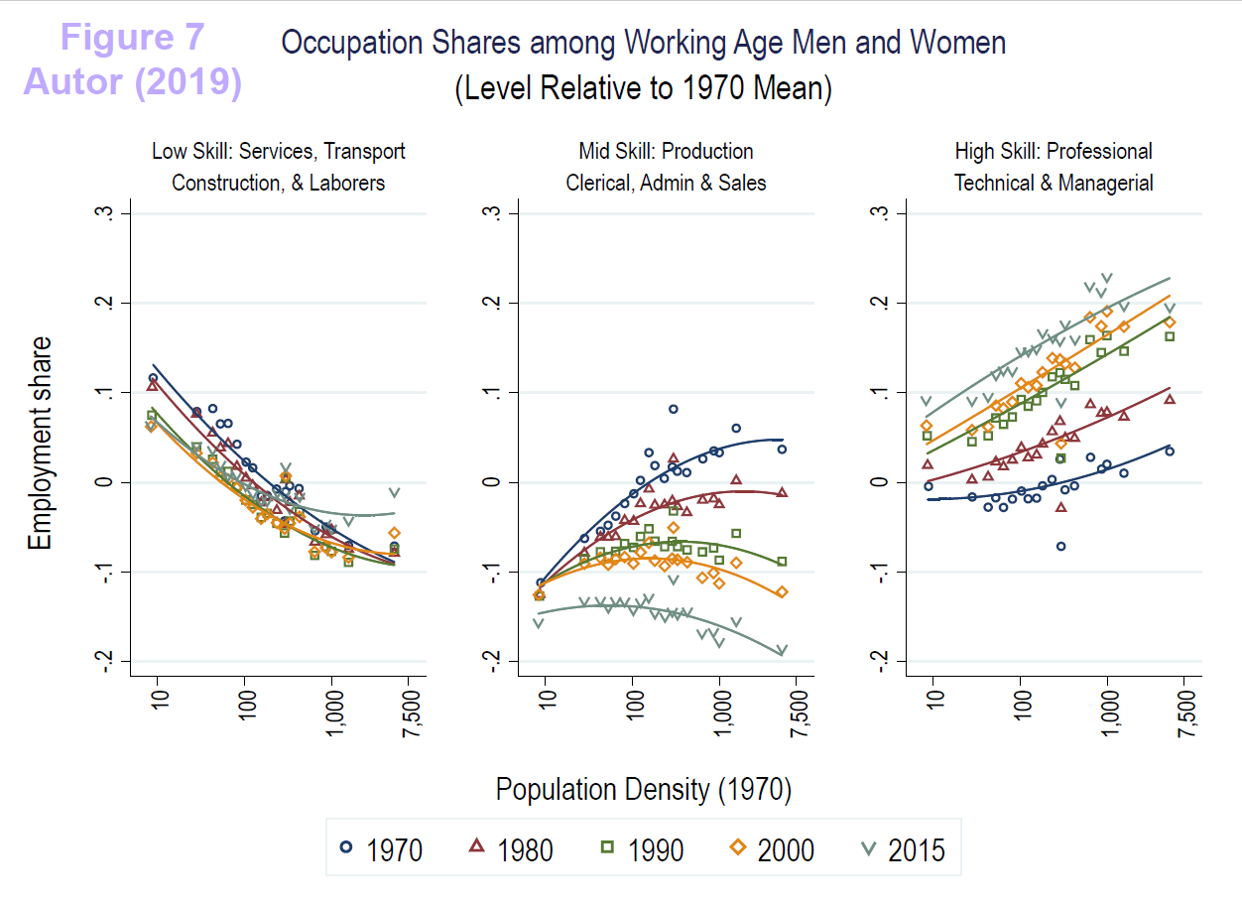
Notes:
Conclusion:
Reinforces the conclusions that the decline of middle-skill employment is fully absorbed by a simultaneous rise in high-skill employment. There is No aggregate change in the share of workers employed in low-skill jobs.
Three fresh insights:
The fraction of workers engaged in low-skill occupations has historically been smaller in high-density CZs, and this gradient has changed little over decades.
denser CZs have been more intensive in high-skill work, the level and slope of this density-skill-intensity relationship rose consistently.
denser CZs were exceptional in the 1970s in having more middle-skill work than suburban & rural CZs. But this exceptional feature attenuated and subsequently reversed sign over the next four decades.

Slide 10
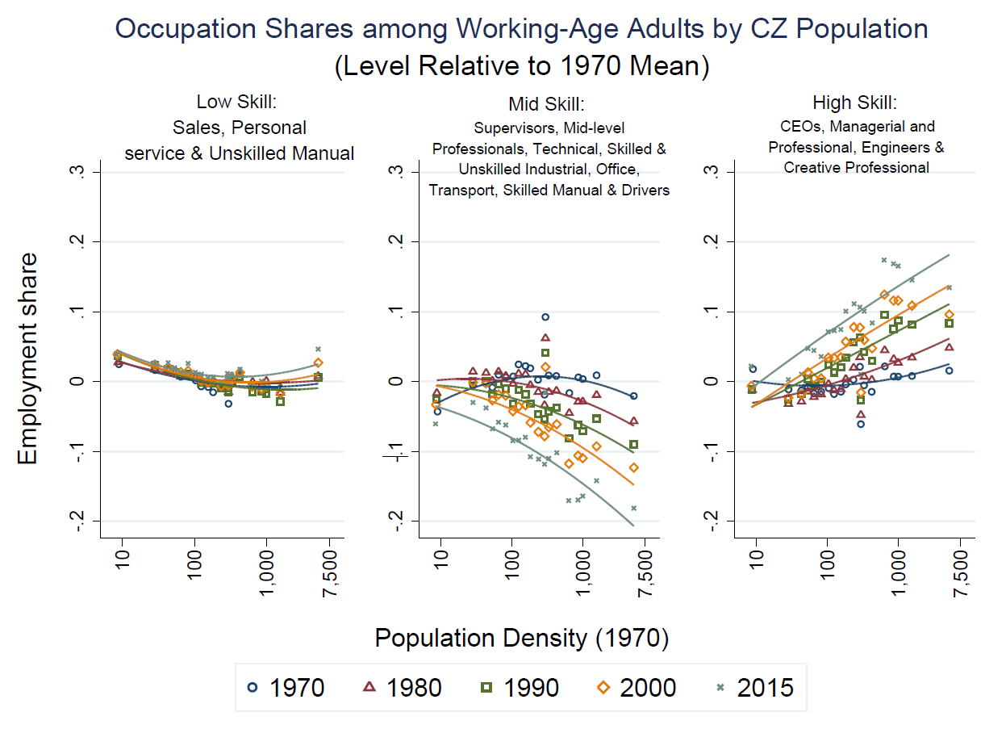
Low-Paying
Mid-Paying
High-Paying
Notes:
Then we apply PCS definitions grouping data into low- mid- high-paying jobs
Changes not significant for low-paying occ over decades. Slightly more intensive in denser area
Mid-paying work dose not have a positive gradient anymore for 1980. the gap between most vs least dense areas are getting bigger and bigger
The fractions of low/middle/high paying work in the least dense areas haven’t changed much for the past 4 decades.
Similar level but reversed sign changes for high-paying occ compared to mid-paying

Slide 11
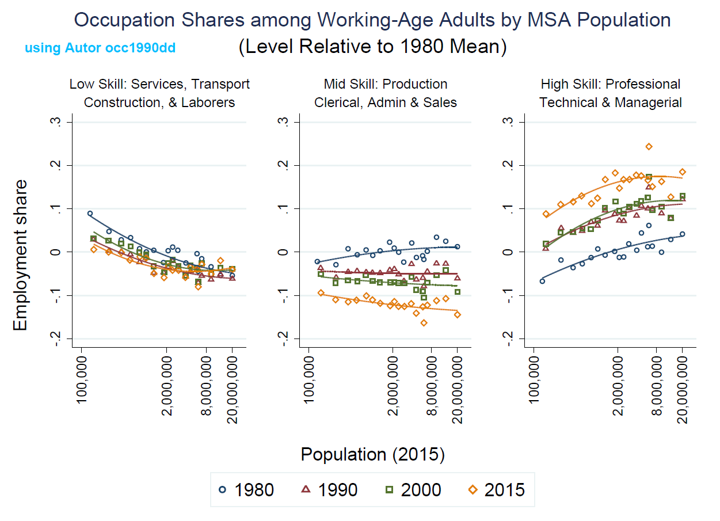
IV. Our Work
1. Occupational Employment Shares by MSA population, 1980-2015.
Notes:
The fraction of workers in low-skill jobs has been smaller in high-populated areas, but the gap between most & least populated areas are smaller.
Do have a slightly positive gradient in 1980 and soon attenuated and reversed sign.
All metropolitans become more intensive in high-skill occ. The level of the population-skill-intensity relation rose consistently but the slope same.

Slide 12
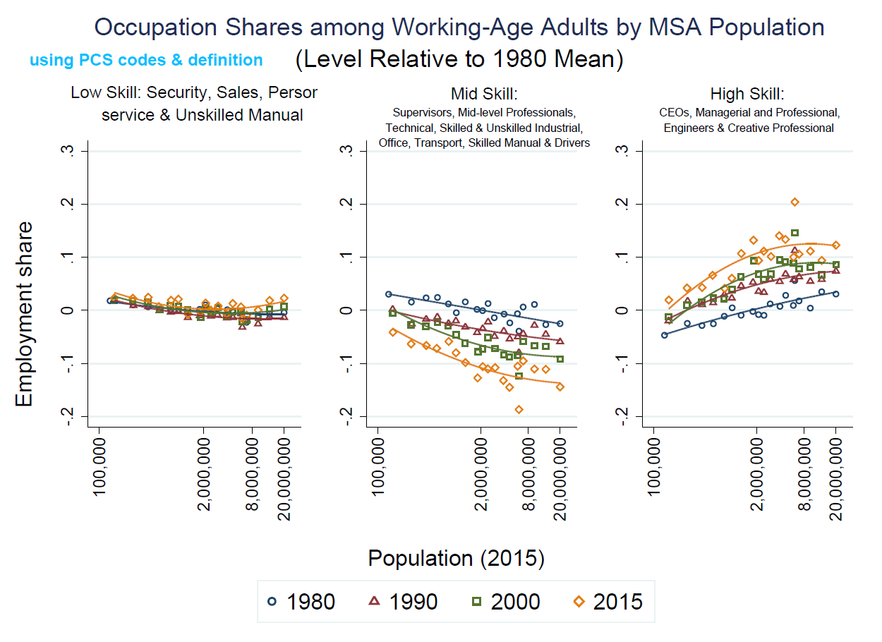
Low-Paying:
Mid-Paying
High-Paying
Notes:
The fraction of workers in low-pay jobs are more constant among MSAs
Donot have a positive gradient anymore. more populated areas are less intensive in mid-pay work.
The level and the slope of the population-paying-intensity relation rose consistently. Especially medium level msa have larger fraction of high-pay occ.

Slide 13
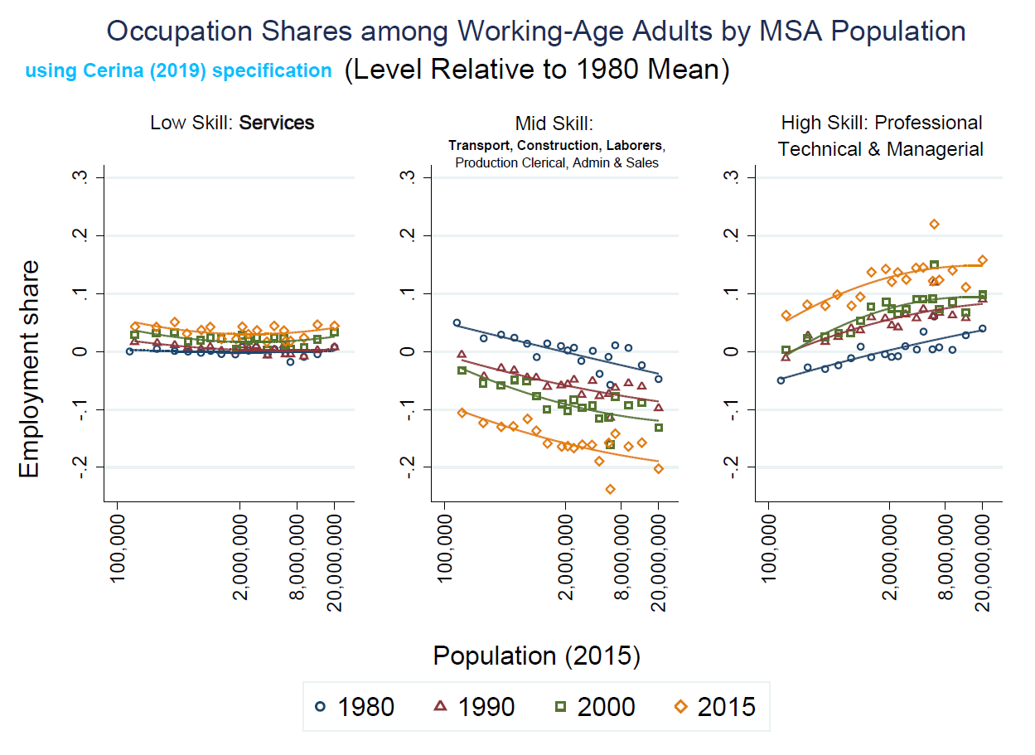
Notes:
Generally, the lines look parallel.
For all the three occ categories, we can observe the changes in levels but not significant in slope.
The gap between most vs least populated areas are pretty stable.
For all MSAs, we have a increase in the fraction of low/high skill work and a decrease in the fraction of mid-skill work

Slide 14
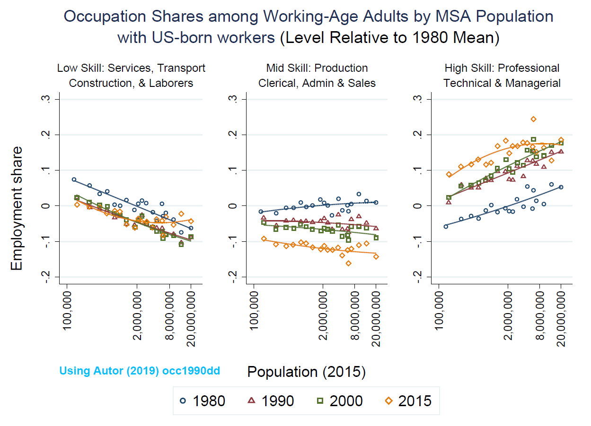
2. Occupational Employment Shares among US-born workers
Notes:
For only consider us-born workers
Similar for mid-skill work,
In highly populated cities like NY & LA, the share of high-skill occ among us-born workers is pretty constant for the past 15 yrs; while the fraction of low-skill work increased by about 5% points.

Slide 15
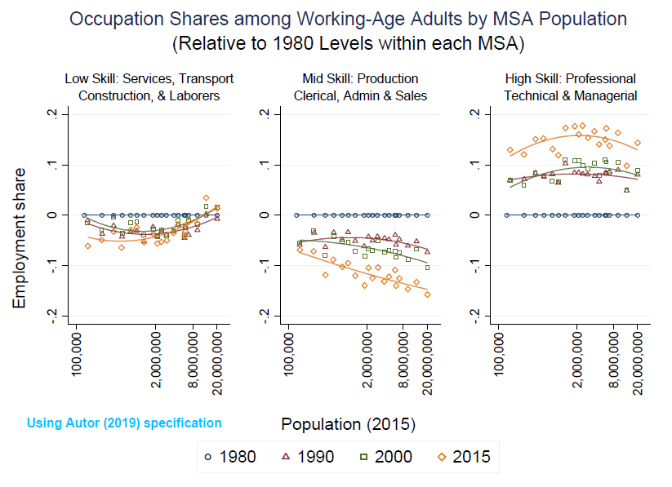
3. Relative to 1980 Levels within each MSA
Notes:
All MSAs are less intensive in low-skill work, despite the slight increase in highly-populated areas
All MSAs are less intensive in mid-skill work, highly-populated areas bear the most changes.
All MSAs are more intensive in high-skill work, medium-size areas have the most increase in fractions.

Slide 16
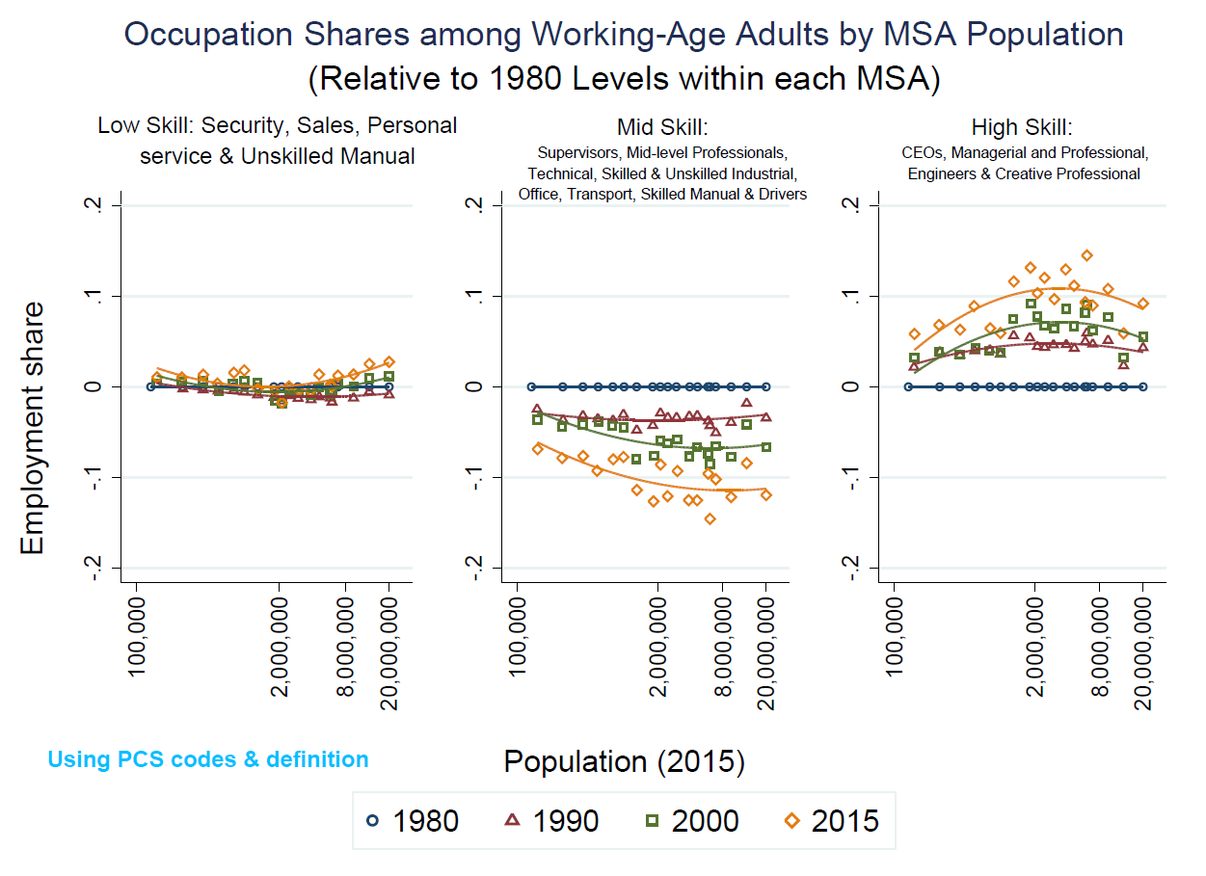
3. Relative to 1980 Levels within each MSA
Low-Paying:
Mid-Paying
High-Paying
Notes:
Basically the same
But for low-skill work, it does not change that much among MSAs and there are a slight increase in the share of low-skill occ in highly-populated areas.

Slide 17
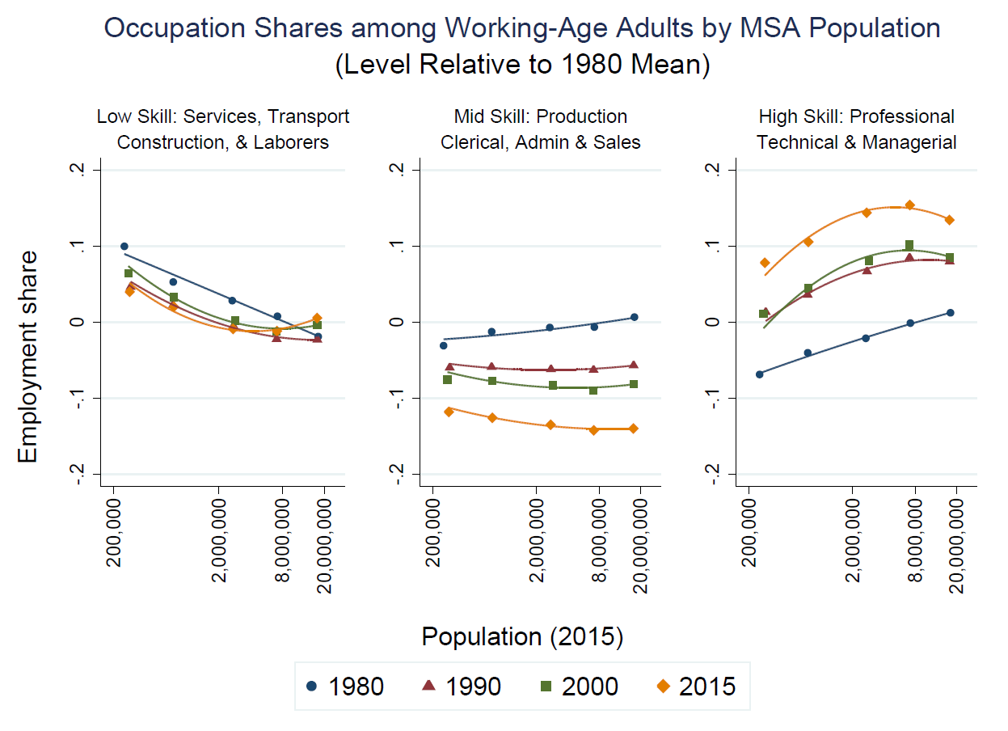
4. Employment shares relative to the levels in 1980 within each city bin
We consider several city classes, and here each bin is pinned down on the x-axis using the average population within groups (calculated from data using 2015 baseline population).
The data (for population less than 100k) are available for all years.
<100k, 100-500k, 500k-1m, 1m-5m, 5m-10m, >10m. (5 bins)

Slide 18
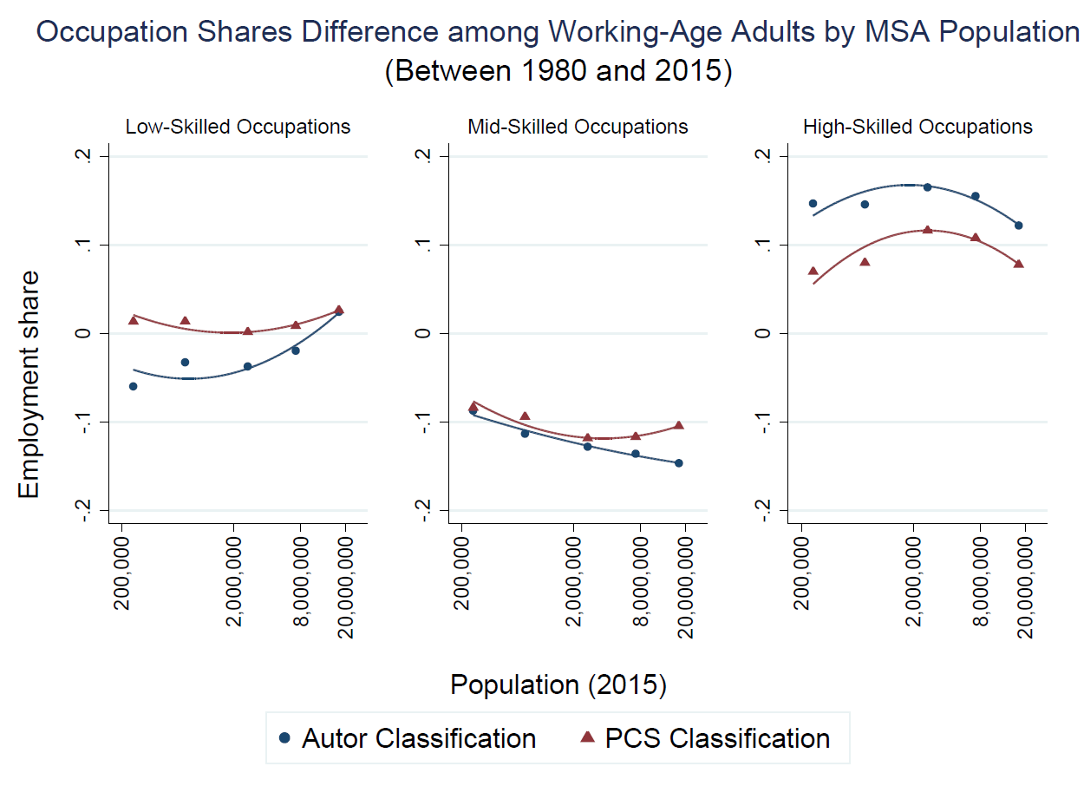
<100k, 100-500k, 500k-1m, 1m-5m, 5m-10m, >10m. (5 bins)
Notes:
Now focus on the difference between 1980 n 2015
We have two major classifications here.
For low-skill work, pcs has positive changes for both most n least populated areas; in contrast, based on autor, only positive changes in most populated areas.
Both negative changes for mid-skill work among MSA. For most populated areas the change is smaller based on PCS.
Both positive changes for high-skill occ among MSA. The level of changes based on Autor is higher.

Slide 19
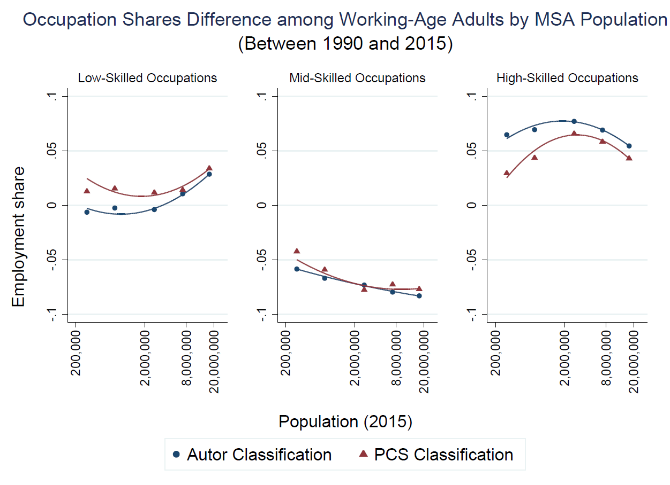
<100k, 100-500k, 500k-1m, 1m-5m, 5m-10m, >10m. (5 bins)

Slide 20
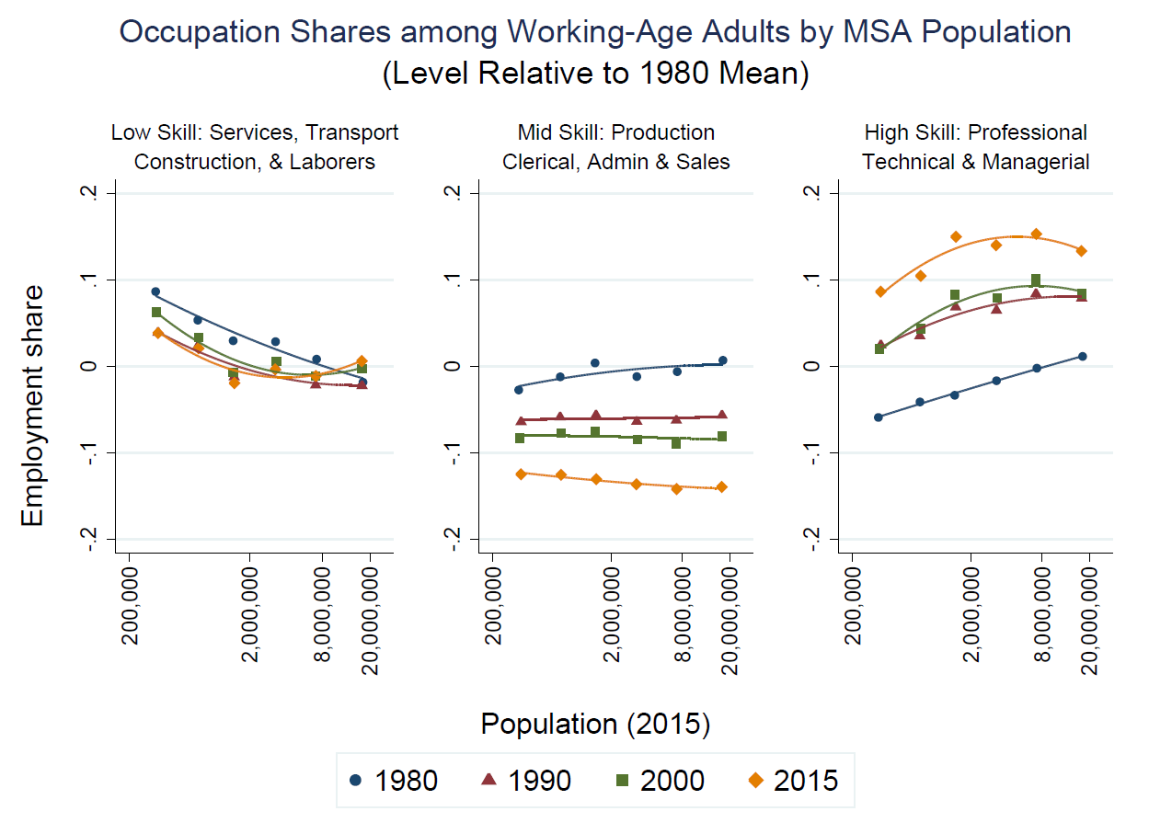
5. Employment shares relative to the levels in 1980 within each city bin
200-500k, 500k-1m, 1m-2m, 2-5m, 5m-10m, >10m (6 bins)
Notes:
Consider different definitions for grouping, the shape of lines are similar

Slide 21
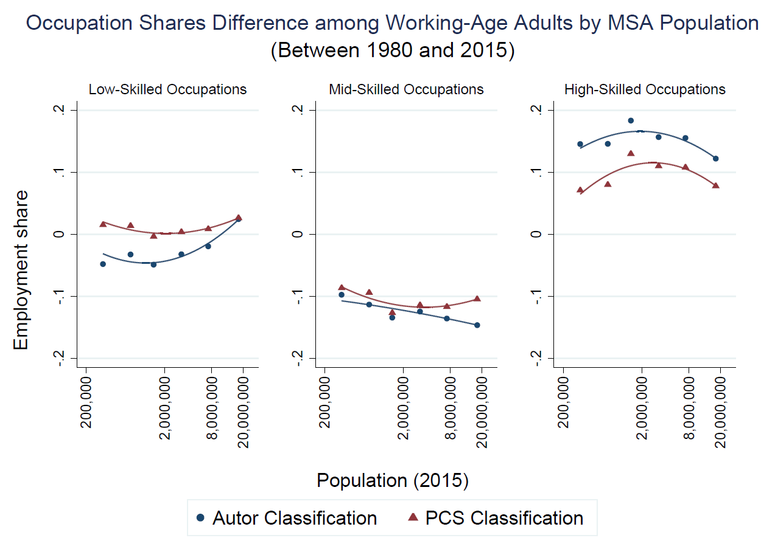
200-500k, 500k-1m, 1m-2m, 2-5m, 5m-10m, >10m (6 bins)

Slide 22
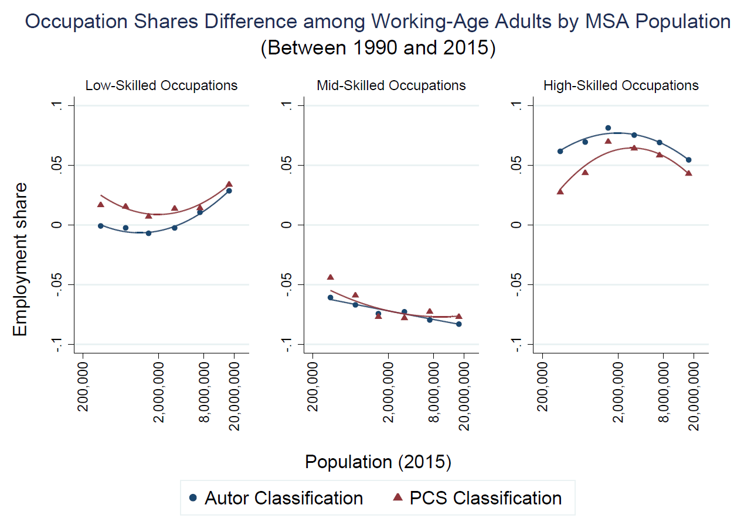
200-500k, 500k-1m, 1m-2m, 2-5m, 5m-10m, >10m (6 bins)

Slide 23
Thank You!

